Slide 1
Analysis On SAT Participation Rates

Slide 2
Background
The College Board, an organization that administers the SAT, looks at statewide SAT test participation rates.
With a new format for the SAT released in March 2016, the College Board is looking to identify states with low SAT test participation rates from 2017 to 2019, and seeks recommendations to help improve them.

Slide 3
Problem Statement
Identify states with low SAT participation rates from 2017 to 2019.
Provide recommendations on how to improve them.

Slide 4
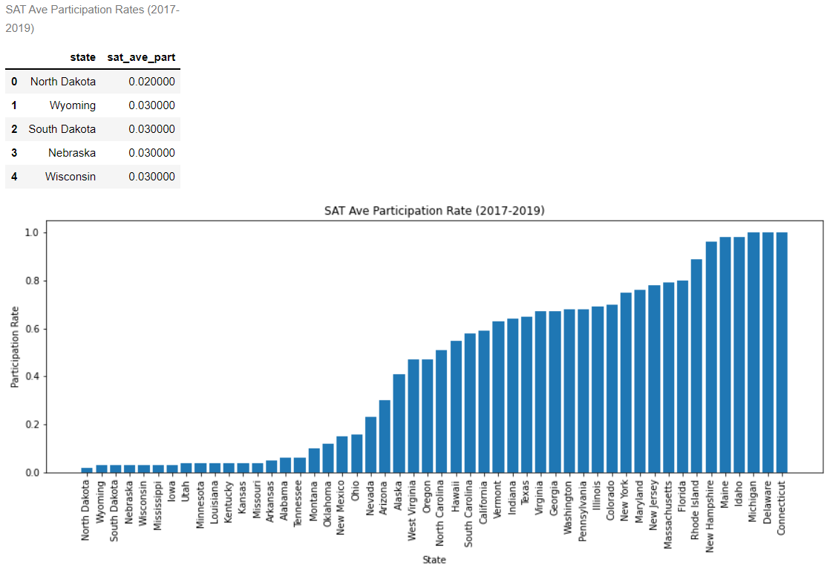
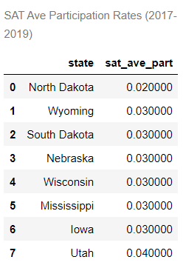
States With Low SAT Average Rates (2017-2019)
Definition: low average SAT rates of < 20%.
States with SAT participation rates of 2-3%, are generally states located at the Central Northern side of US – e.g. North Dakota, Wyoming, South Dakota.

Slide 5
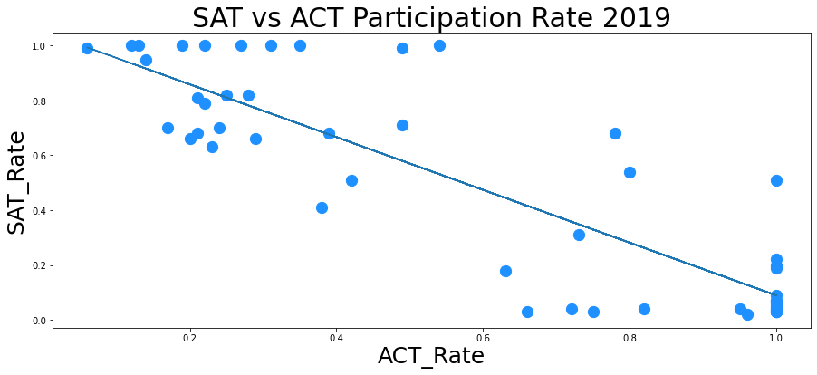
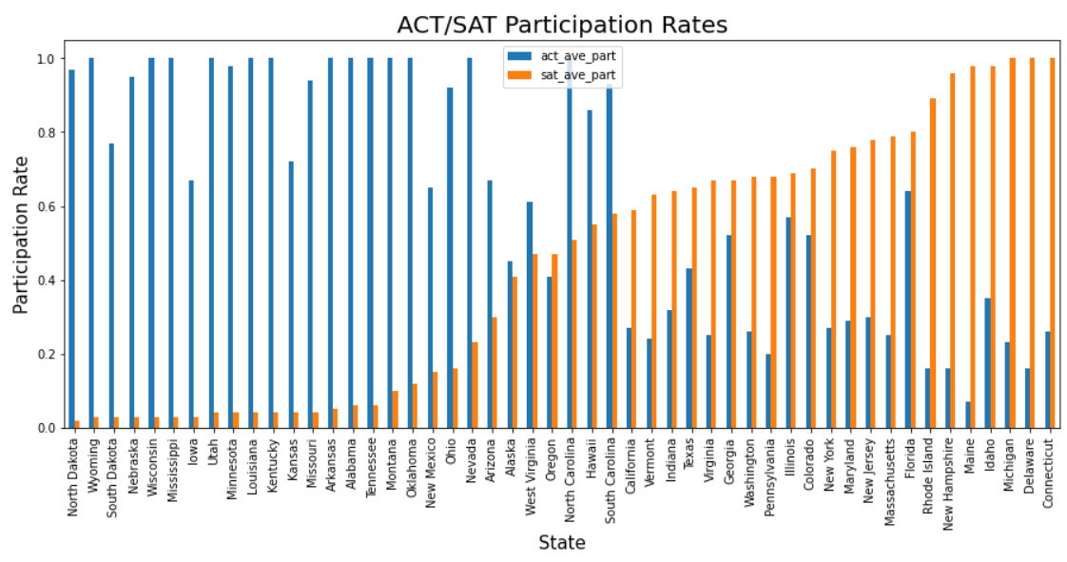
Trends – SAT vs ACT Participation Rates
Inverse correlation between SAT and ACT participation rates.
States with lower SAT participation tend to have higher ACT participation rates.
States with SAT participation rate of <20% have >60% ACT participation rates.

Slide 6
Trends – SAT vs ACT Participation Rates (cont.)
What this means:
Most students take only either SAT or ACT test.
States with better outreach by SAT college board might have better SAT participation.
E.g. fewer SAT test centers than ACT test centers in North Dakota, Wyoming, South Dakota.
State | SAT Test Centre Count | ACT Test Centre Count | Test Centre Ratio | SAT Participation Rate
North Dakota | 3 | 45 | 0.07 | 0.02
Wyoming | 3 | 44 | 0.07 | 0.03
South Dakota | 4 | 61 | 0.07 | 0.03
Connecticut | 33 | 58 | 0.57 | 1.00
Delaware | 8 | 10 | 0.80 | 1.00
Michigan | 62 | 239 | 0.26 | 1.00
Data source: https://www.topschoolsintheusa.com/

Slide 7
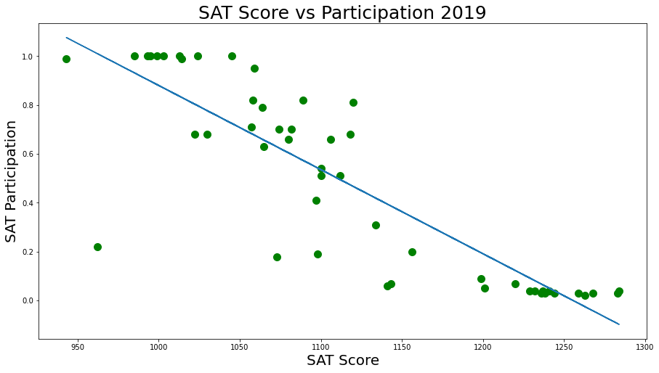
Trends – SAT Score vs Participation Rates
Inverse correlation between SAT score and participation rates.
States with lower participation rates tend to have better SAT scores.

Slide 8
Trends – SAT Score vs Participation Rates (cont.)
What this means:
Higher participation rates means that a greater proportion of average college bound students are taking the SAT test, which lowers the average SAT scores.
States with high average SAT scores and low participation rates, could indicate that an average student from the state is less confident and willing to take the SAT test.

Slide 9
Summary
States with very low SAT participation rates of 2-3%, are generally located at the Central Northern side of US.
Low SAT participation rates could be linked to poor outreach, lesser or SAT related resources in the state (e.g. test centers). Furthermore as students generally take only 1 test of their preference, this increases the importance of outreach by SAT college board.
A state’s SAT score to participation rate is an indication on the confidence of an average student of a state to take the SAT test.

Slide 10
Recommendation
Increase outreach programs to schools in states with low SAT participation, targeting states with low SAT related resources such as test centres, such as North Dakota/Wyoming/South Dakota.
Educate on SAT test requirements, and inform on how widely SAT results are accepted in US colleges.
Provide additional teaching resources and materials to improve confidence of students in states with high SAT scores, but low participation rates

Slide 11
Future Improvement
Limited 3 years data used for the assessment.
Factors contributing to low participation rates are not limited to the mentioned few. More studies can be done based on other factors e.g. state requirements.

Slide 12
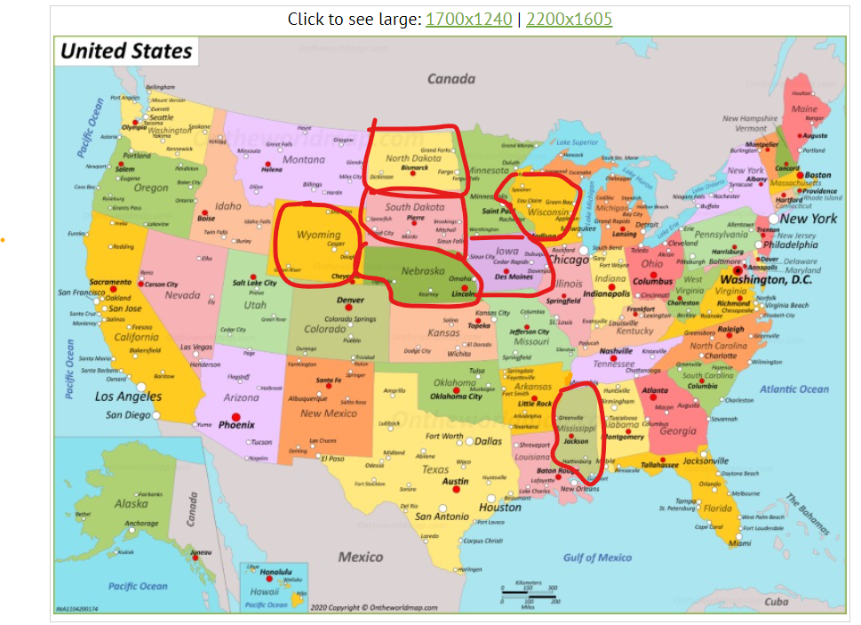

Slide 13
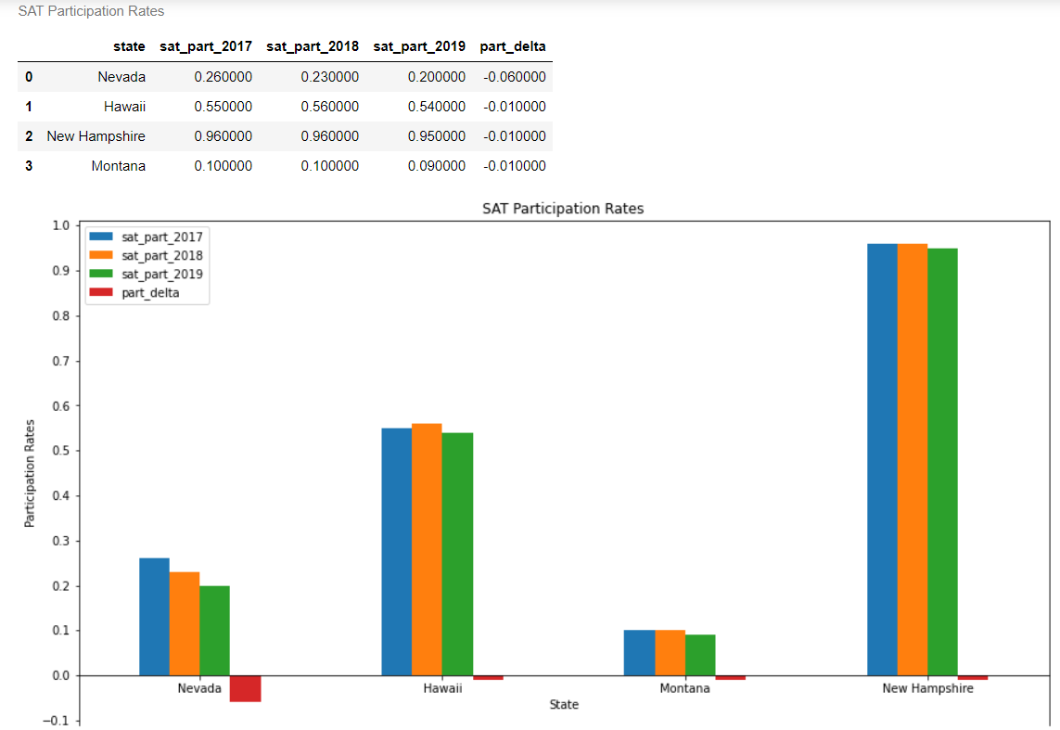
States With Decreasing SAT Rates (2017–2019)
4 states with decreasing SAT rates.
Nevada with overall decrease in SAT rates by ~6%.

